Slide 1


Introduction to Machine Learning
Eng. Fatma Gamal

Slide 2

What is Artificial Intelligence
It is a branch of computer science by which we can create intelligent machines which can behave like a human, think like humans, and able to make decisions.

Slide 3
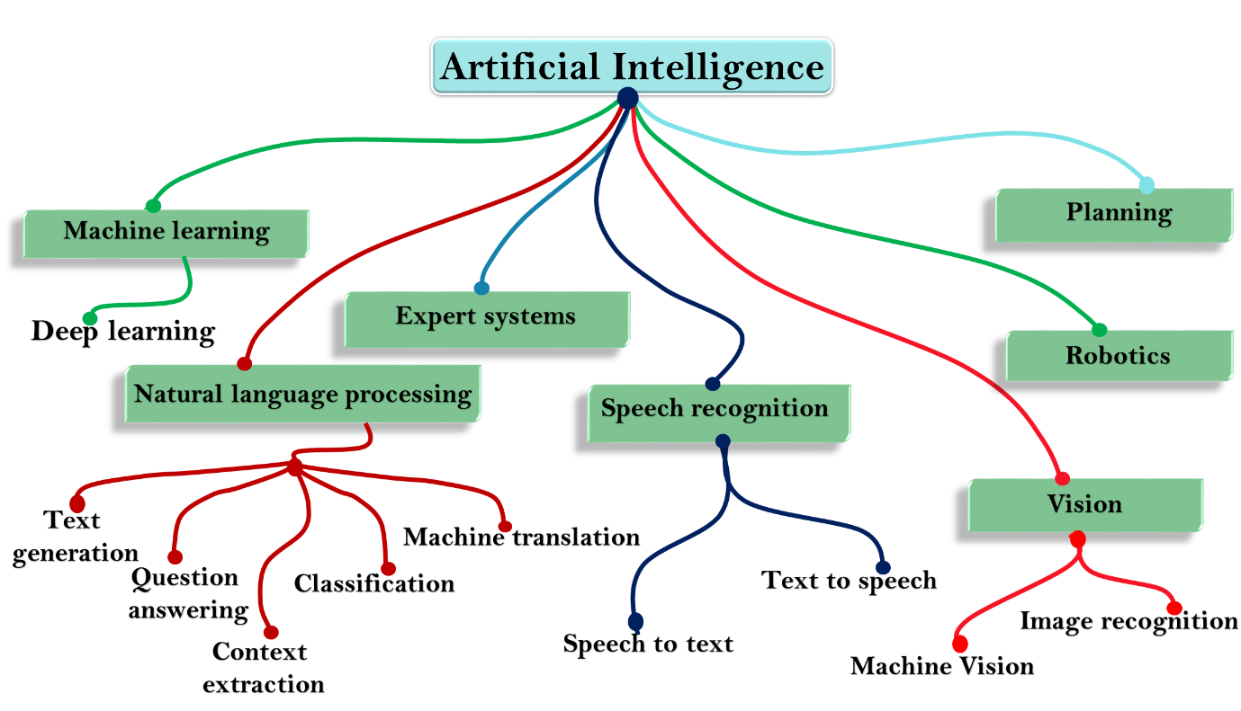

Slide 4

What is Machine Learning
Machine learning is a subset of AI that enables a machine to automatically learn from data, improve performance from experiences, and predict things without being explicitly programmed.

Slide 5
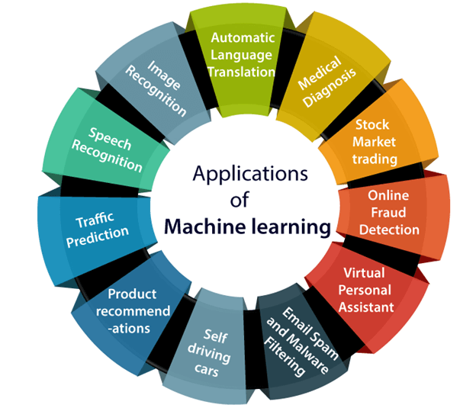
Machine Learning Applications

Slide 6

The Essene of Machine Learning
A pattern exists
We can’t pin it down mathematically
We have data on it

Slide 7
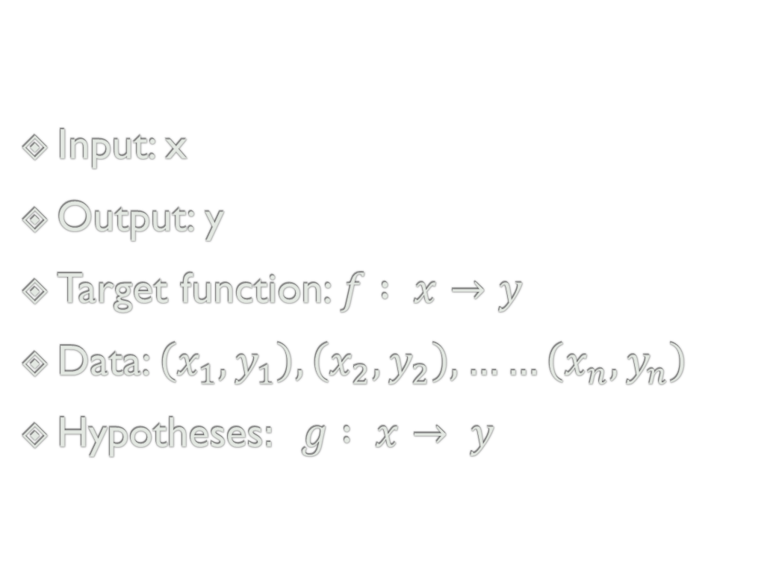
Learning Component
Input: x
Output: y
Target function: $f : x→y$
Data: $\left(x_{1},y_{1}\right), \left(x_{2},y_{2}\right), ……\left(x_{n},y_{n}\right)$
Hypotheses$: g : x→ y$

Slide 8
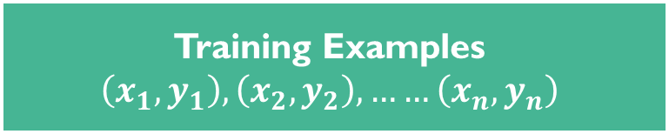

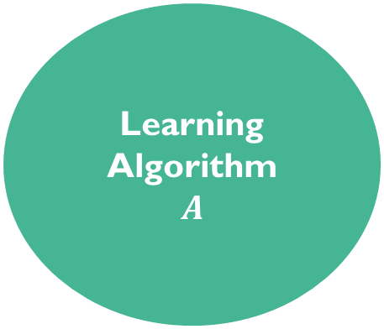

Unknown Target Function
$$f:x→y$$
Training Examples
$$\left(x_{1},y_{1}\right), \left(x_{2},y_{2}\right), ……\left(x_{n},y_{n}\right)$$
Learning Algorithm
$$A$$
Final Hypothesis
$$g≈f$$
Hypothesis Set
H

Slide 9
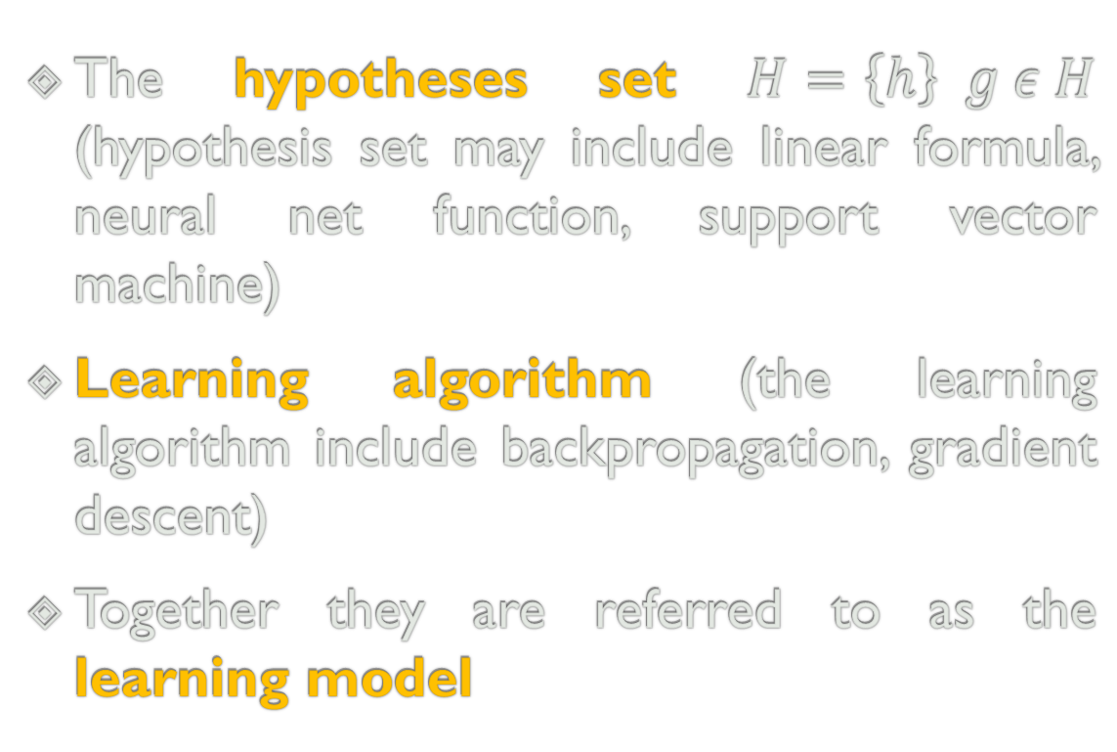
Solution Component
The hypotheses set $H=\left\{h\right\} g ε H$ (hypothesis set may include linear formula, neural net function, support vector machine)
Learning algorithm (the learning algorithm include backpropagation, gradient descent)
Together they are referred to as the learning model

Slide 10
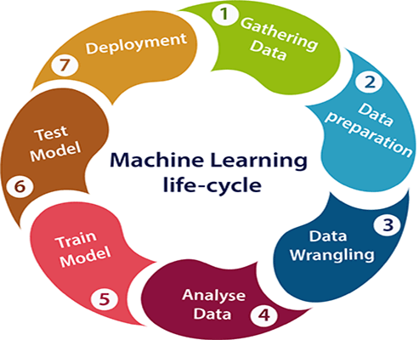
Machine Learning Life Cycle

Slide 11
Learning Types
Supervised learning
Unsupervised learning
Reinforcement learning

Slide 12
Supervised learning
Supervised learning is a type of machine learning method in which we provide sample labeled data to the machine learning system in order to train it, and on that basis, it predicts the output.
The goal of supervised learning is to map input data with the output data.

Slide 13
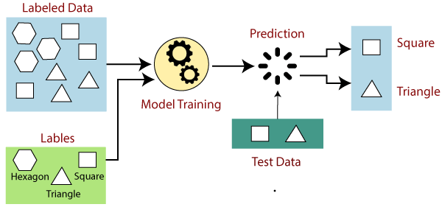

Slide 14
Unsupervised learning
Unsupervised learning is a learning method in which a machine learns without any supervision.
The training is provided to the machine with the set of data that has not been labeled, classified, or categorized.
The goal of unsupervised learning is to restructure the input data into a group of objects with similar patterns.

Slide 15
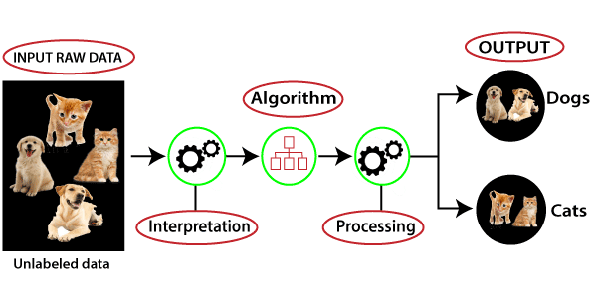

Slide 16
Reinforcement learning
Reinforcement learning is a feedback-based learning method, in which a learning agent gets a reward for each right action and gets a penalty for each wrong action.
The goal of an agent is to get the most reward points, and hence, it improves its performance.

Slide 17


Slide 18
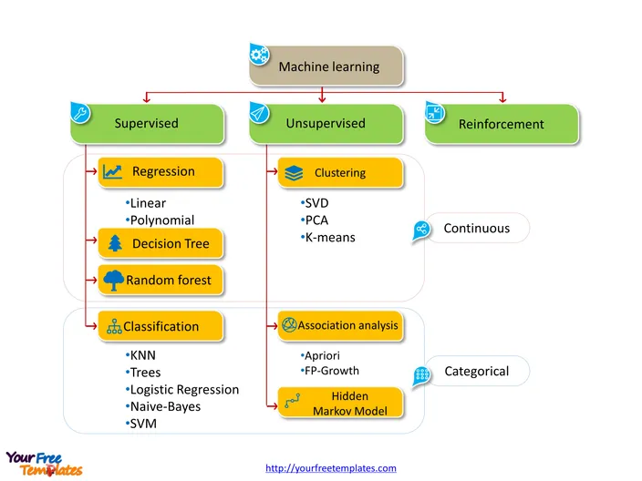

Slide 19
Linear Regression
Linear regression is one of the easiest and most popular Machine Learning algorithms. It is a statistical method that is used for predictive analysis.
Linear regression makes predictions for continuous/real or numeric variables such as sales, salary, age, product price, etc.

Slide 20
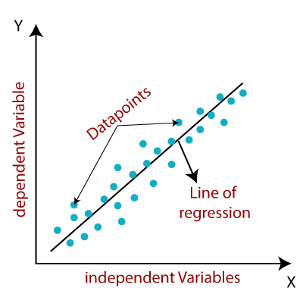

Slide 21
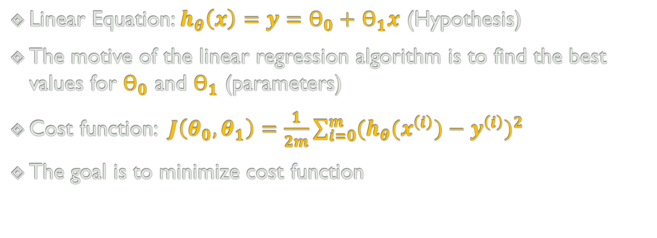
Univariant Linear Regression
Linear Equation: $h_{θ}\left(x\right)=$ $y=ϴ_{0}+$ $ϴ_{1}x$ (Hypothesis)
The motive of the linear regression algorithm is to find the best values for $ϴ_{0}$ and $ϴ_{1}$ (parameters)
Cost function: $J\left(θ_{0},θ_{1}\right)=\frac{1}{2m}\sum_{i=0}^{m}{{(h_{θ}(x^{\left(i\right)})−y^{\left(i\right)})}^{2} }$
The goal is to minimize cost function

Slide 22
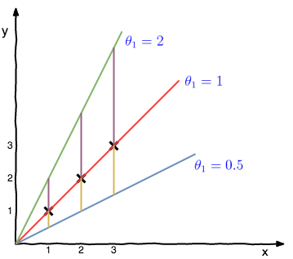
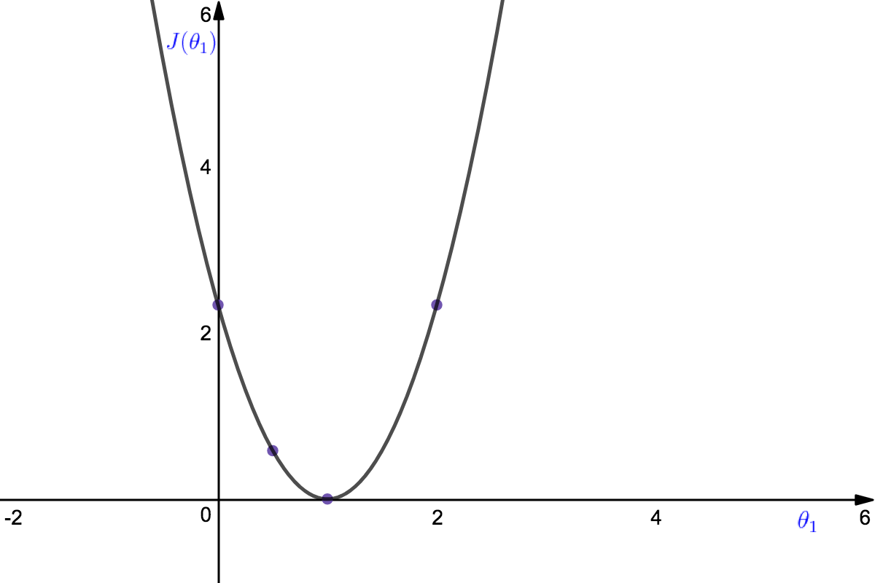

Slide 23
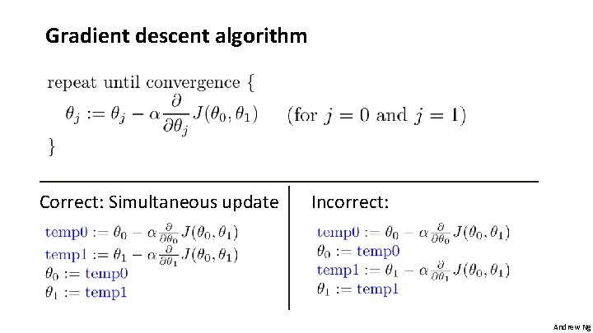

Slide 24
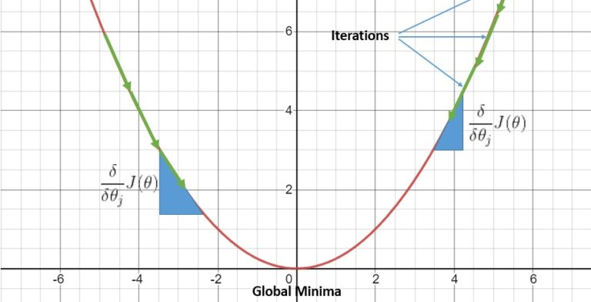

Slide 25
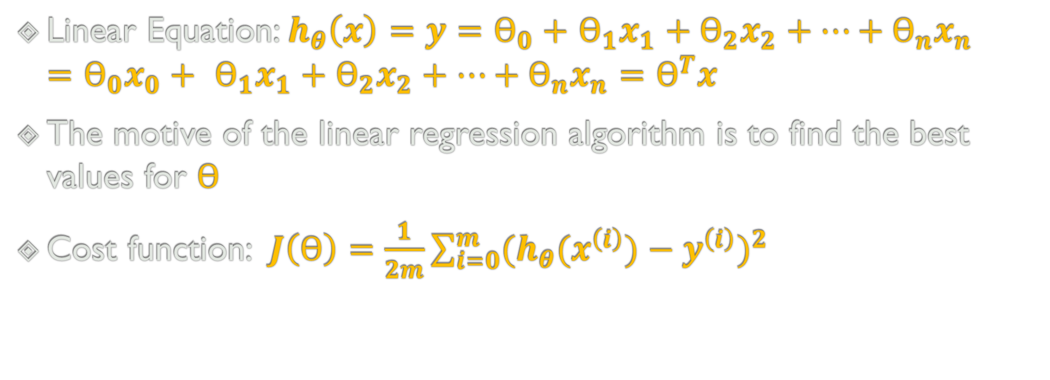
Multivariant Linear Regression
Linear Equation: $h_{θ}\left(x\right)=$ $y=ϴ_{0}+$ $ϴ_{1}x_{1}+ϴ_{2}x_{2}+…+ϴ_{n}x_{n}=ϴ_{0}x_{0}+ ϴ_{1}x_{1}+ϴ_{2}x_{2}+…+ϴ_{n}x_{n}=ϴ^{T}x$
The motive of the linear regression algorithm is to find the best values for $ϴ$
Cost function: $J\left(ϴ\right)=\frac{1}{2m}\sum_{i=0}^{m}{{(h_{θ}(x^{\left(i\right)})−y^{\left(i\right)})}^{2} }$

Slide 26

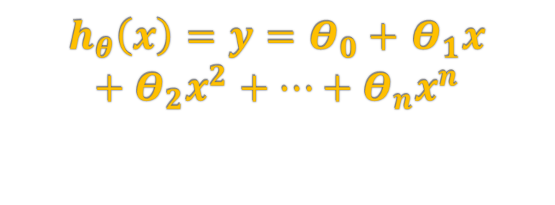
Polynomial Regression
$h_{θ}\left(x\right)=$ $y=Θ_{0}+$ $Θ_{1}x+Θ_{2}x^{2}+…+Θ_{n}x^{n}$

Slide 27
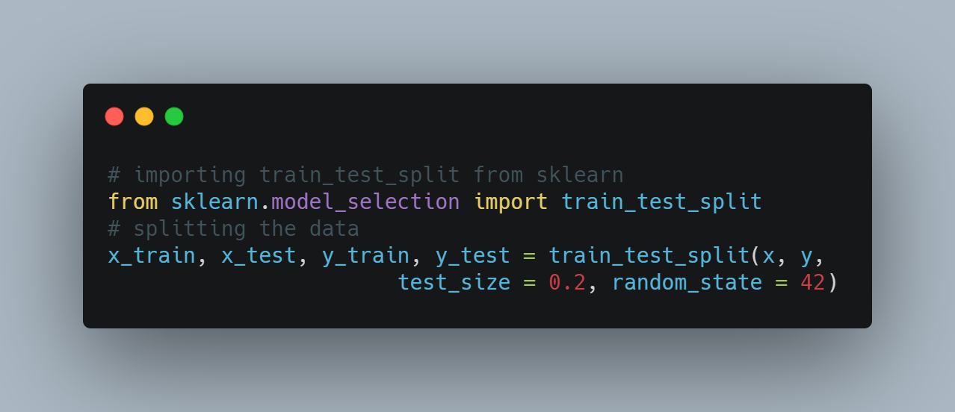
Splitting Data

Slide 28

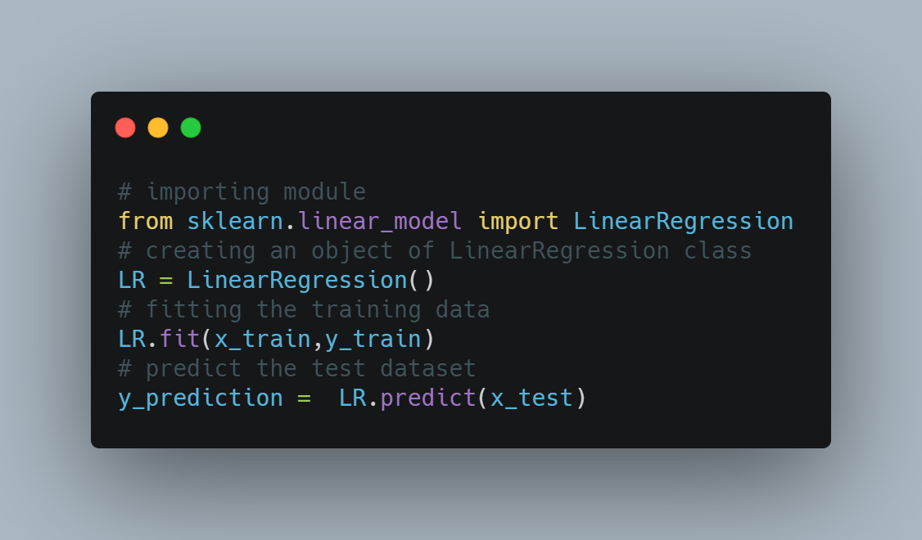

Slide 29

Model Evaluation Techniques
The train/test/validation split
To evaluate the model while still building and tuning the model, we create a third subset of the data known as the validation set.
A typical train/test/validation split would be to use 60% of the data for training, 20% of the data for validation, and 20% of the data for testing.

Slide 30
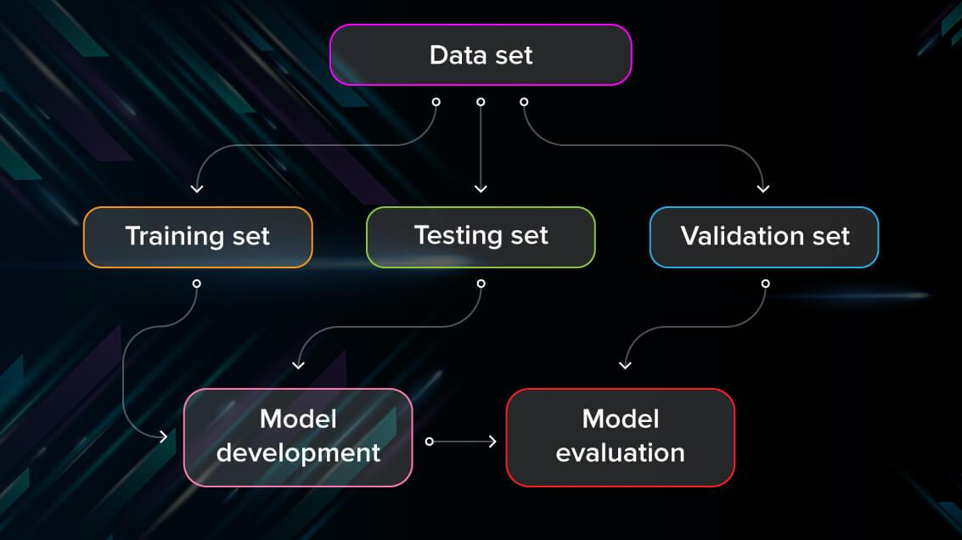

Slide 31
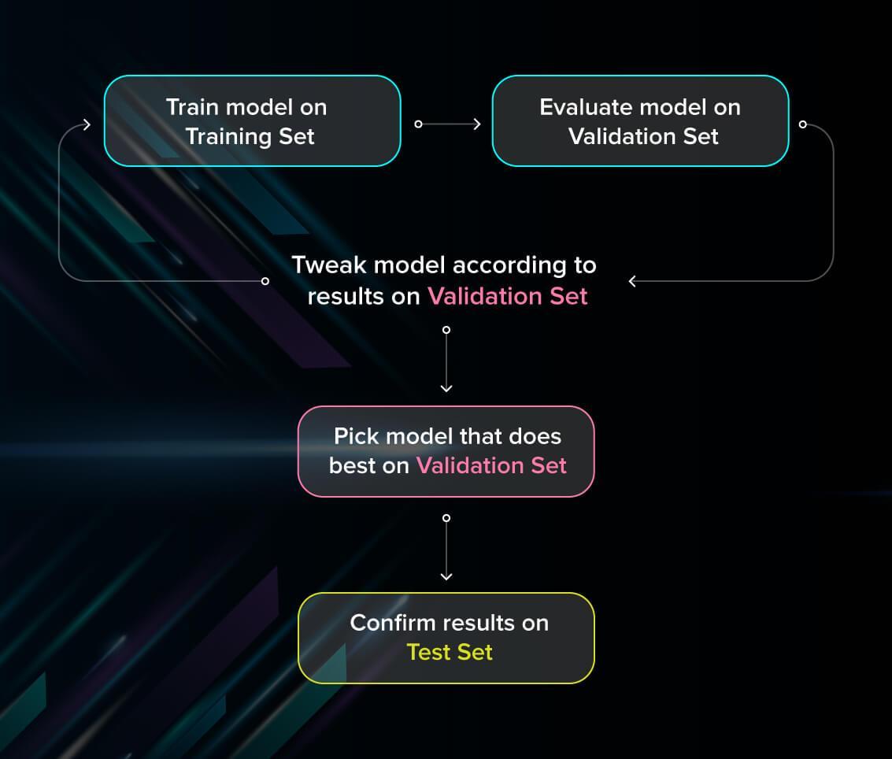

Slide 32

Model Evaluation Techniques (Cont.)
Cross validation technique
Cross-validation is a model evaluation technique that can be performed even on a limited dataset.
The training set is divided into small subsets, and the model is trained and validated on each of these samples.
k-fold, Leave-one-out.

Slide 33
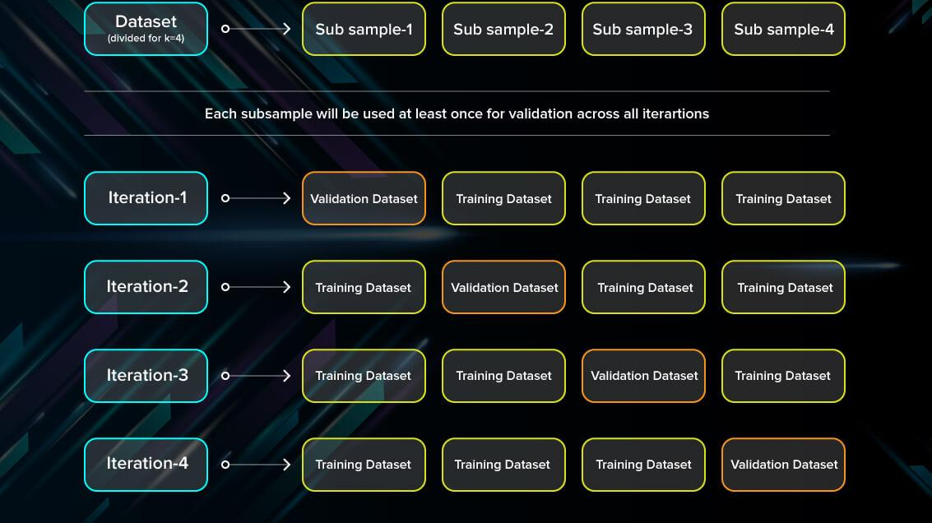

Slide 34
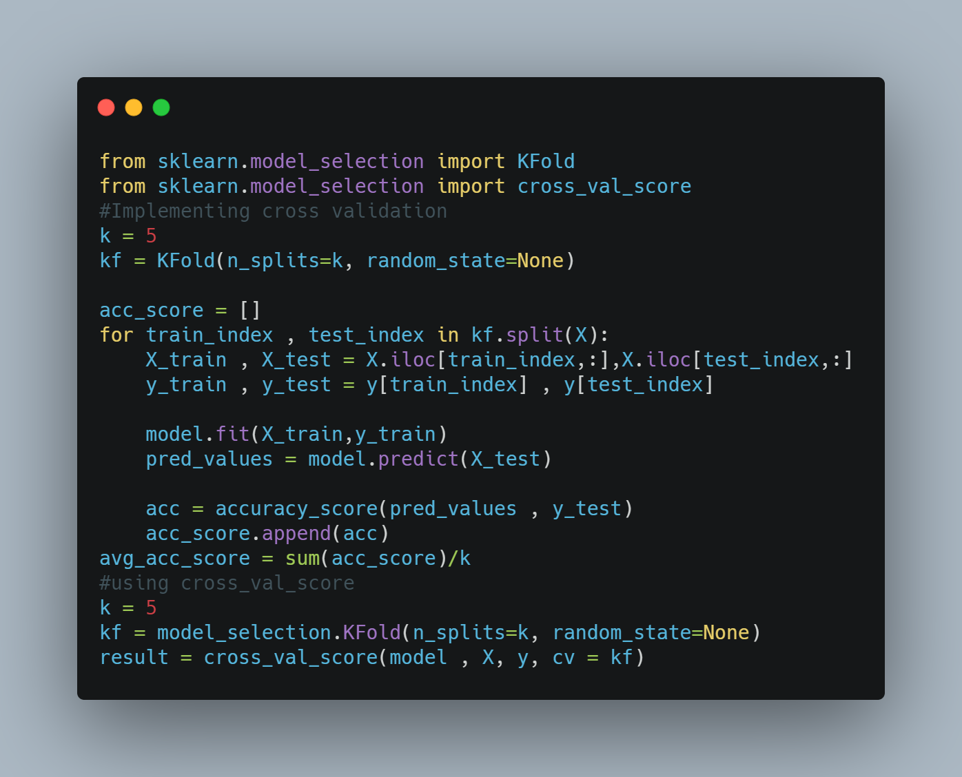

Slide 35
Model Evaluation Techniques (Cont.)
Mean Absolute Error(MAE)
Root Mean Square Error(RMSE)
Coefficient of determination or R2
Adjusted R2

Slide 36
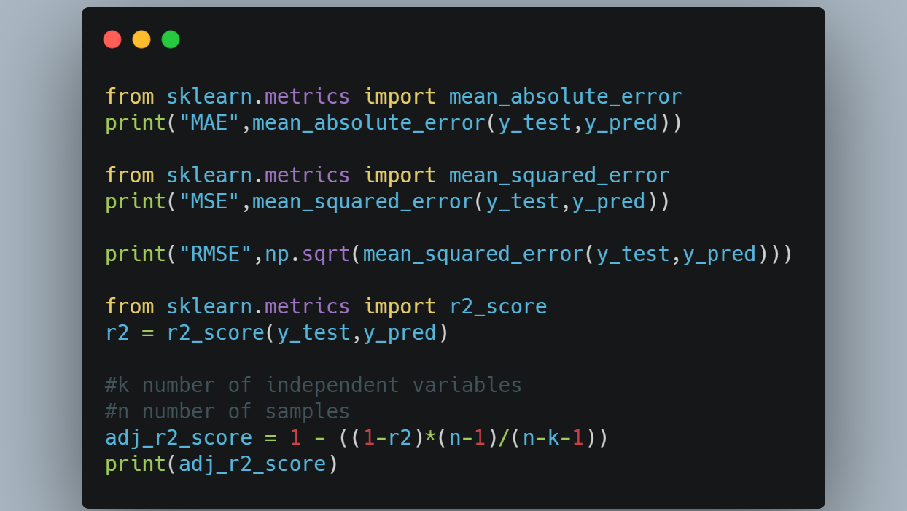

Slide 37
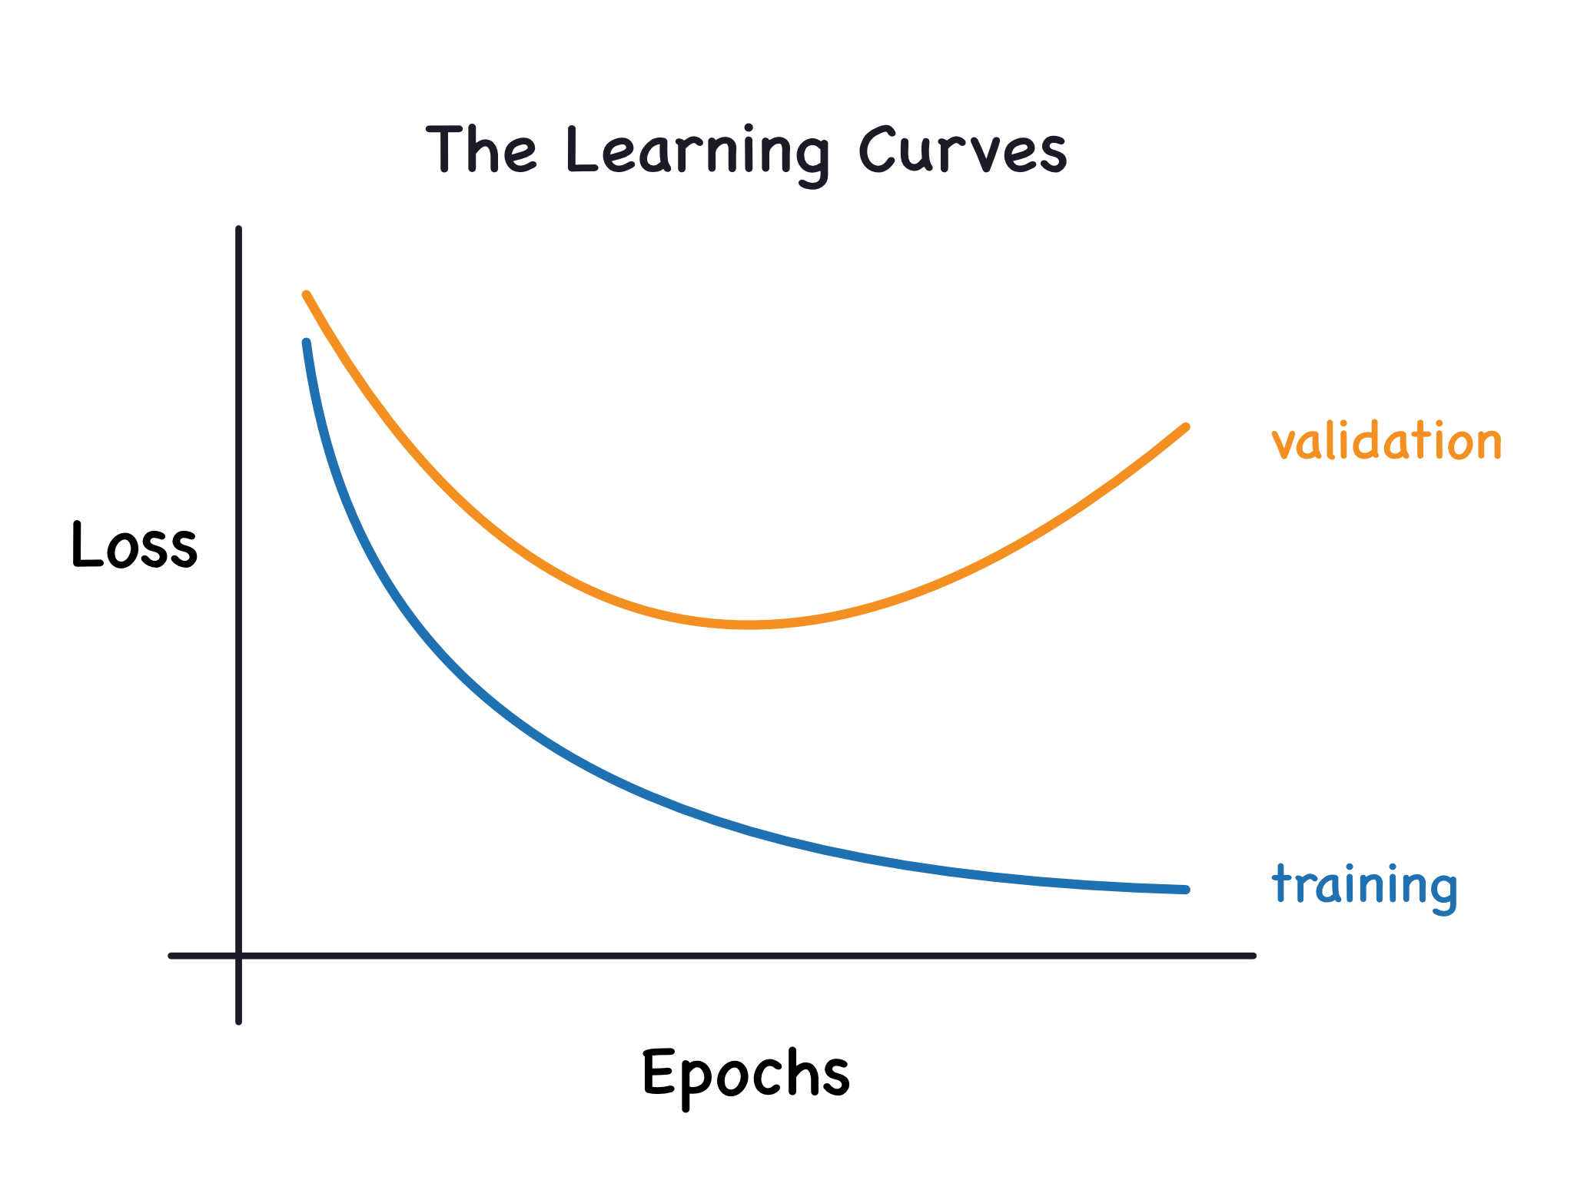
Learning Curves

Slide 38
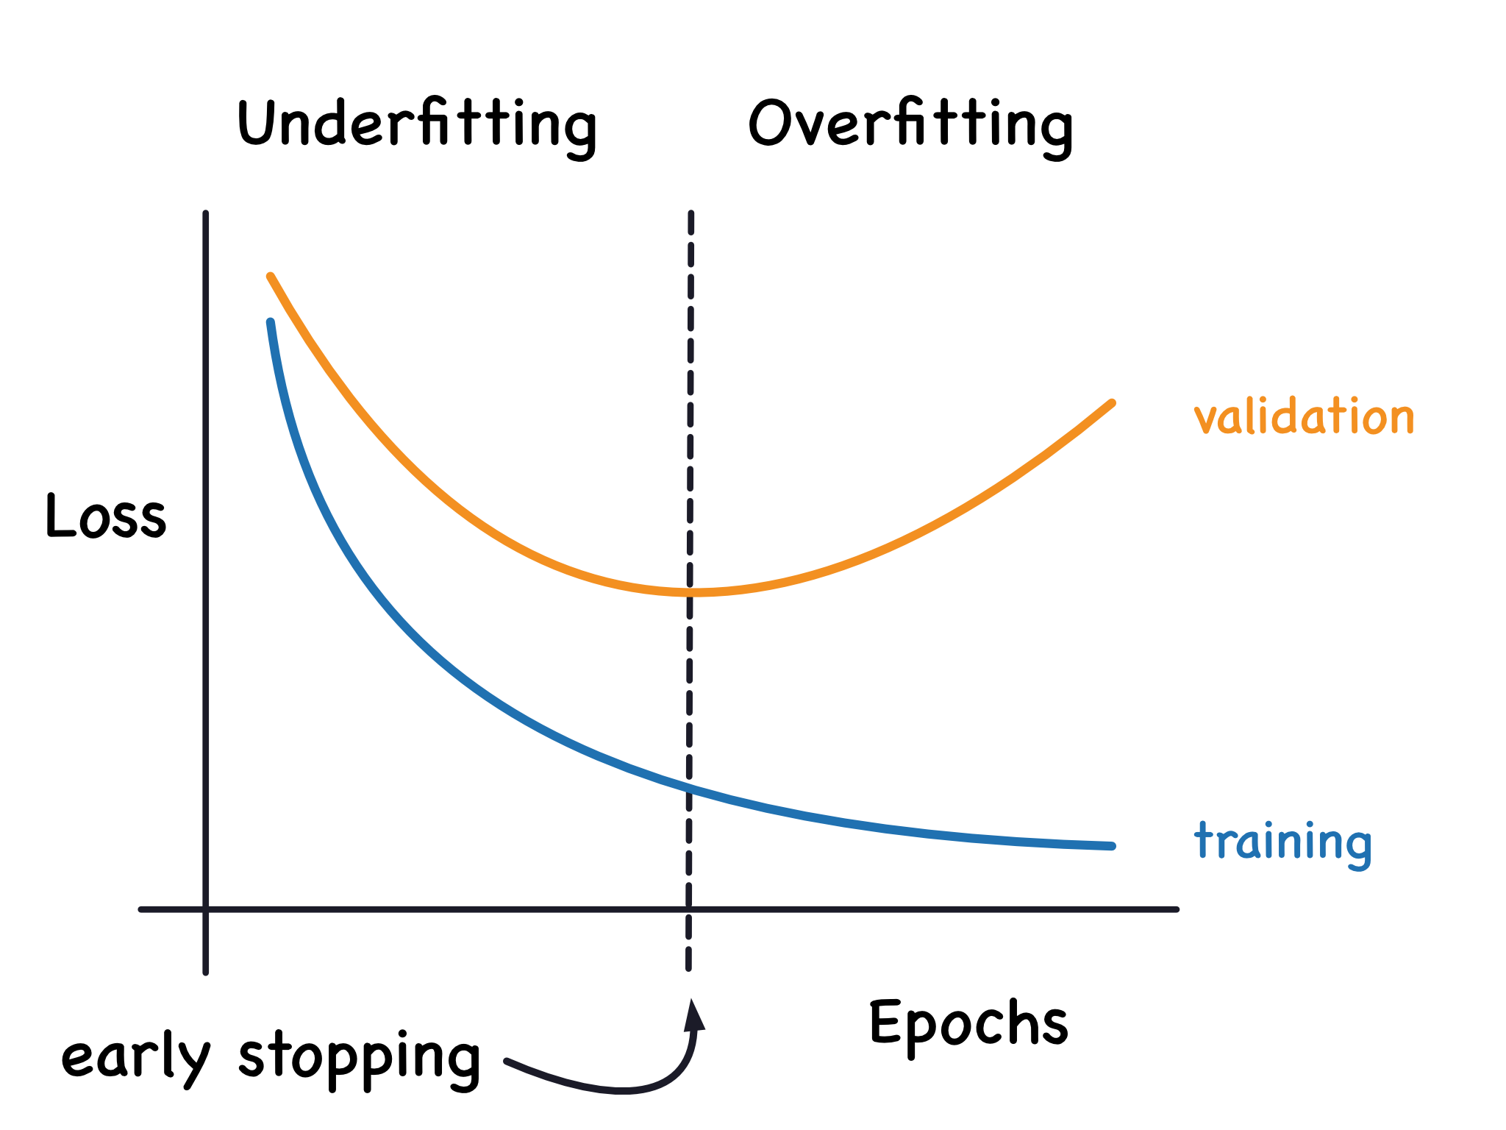
Learning Curves (Cont.)

Slide 39
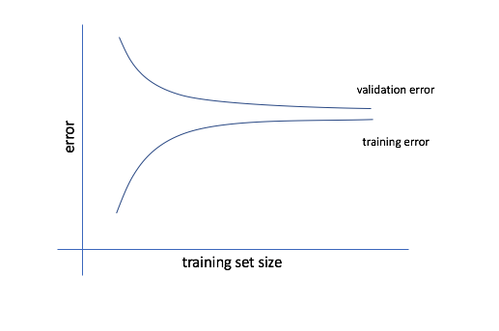

Slide 40
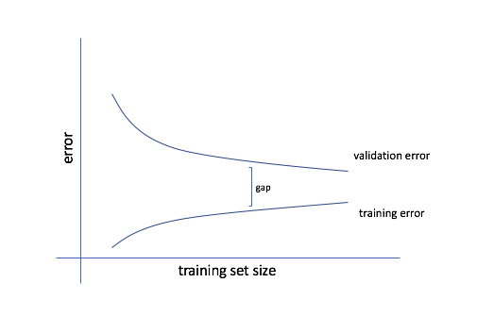

Slide 41
The General Outline of the Machine Learning Pipeline
Data cleaning and formatting
Exploratory data analysis
Feature engineering and selection
Compare several machine learning models on a performance metric
Perform hyperparameter tuning on the best model to optimize it for the problem
Evaluate the best model on the testing set
Interpret the model results to the extent possible
Draw conclusions and write a well-documented report

